Slide 1
On the Geometry of Adversarial Examples Arxiv, 2018
202111259 CSE 김수환

Slide 2

Contents
Abstract
Manifold, Codimension
Theorem
Experiments
Conclusion

Slide 3
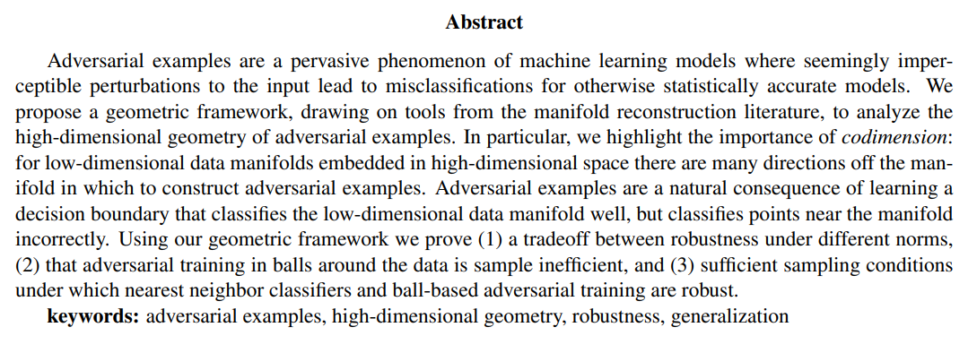


1. Abstract

Slide 4
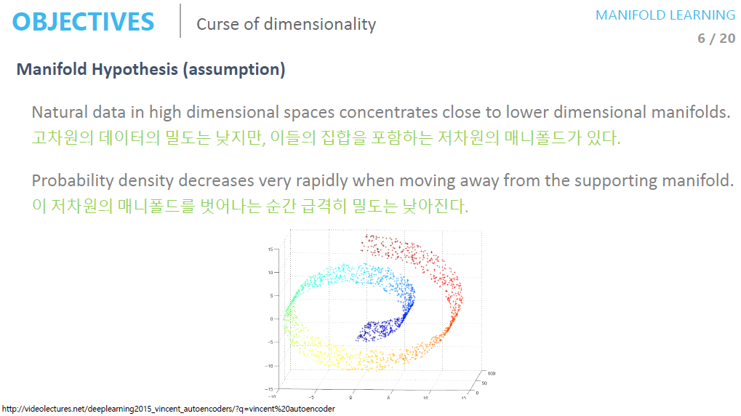
2. Manifold, Codimension
https://deepinsight.tistory.com/124

Slide 5
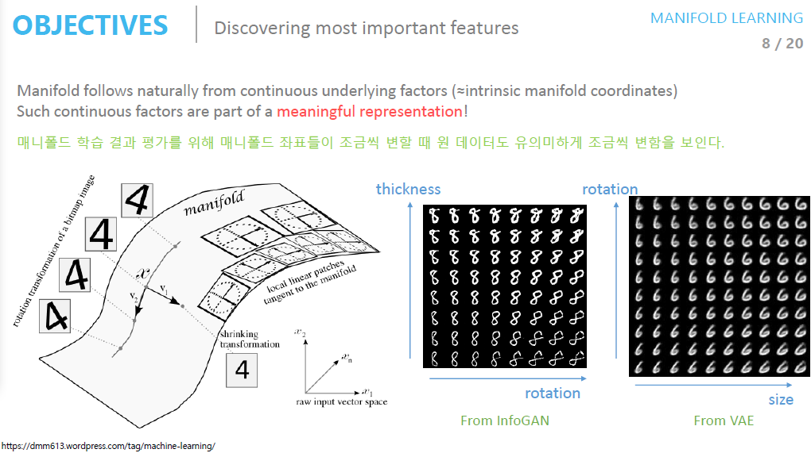
2. Manifold, Codimension
https://deepinsight.tistory.com/124

Slide 6


2. Manifold, Codimension
https://deepinsight.tistory.com/124

Slide 7
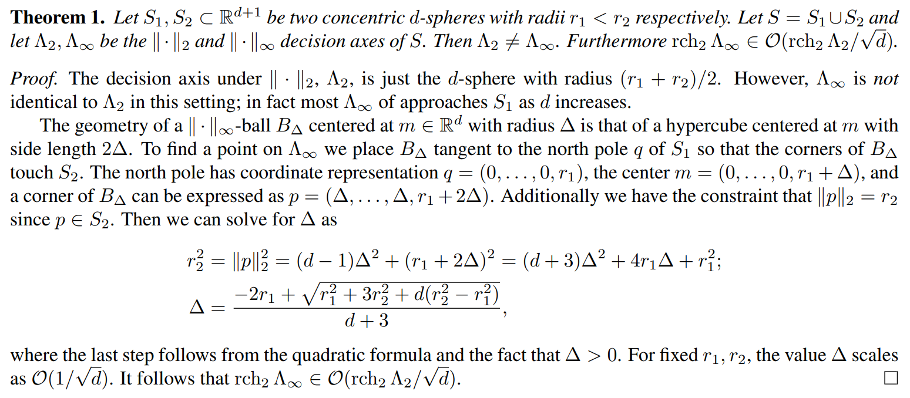

3. Theorem
→ Norm이 다르면 방어하지 못한다

Slide 8
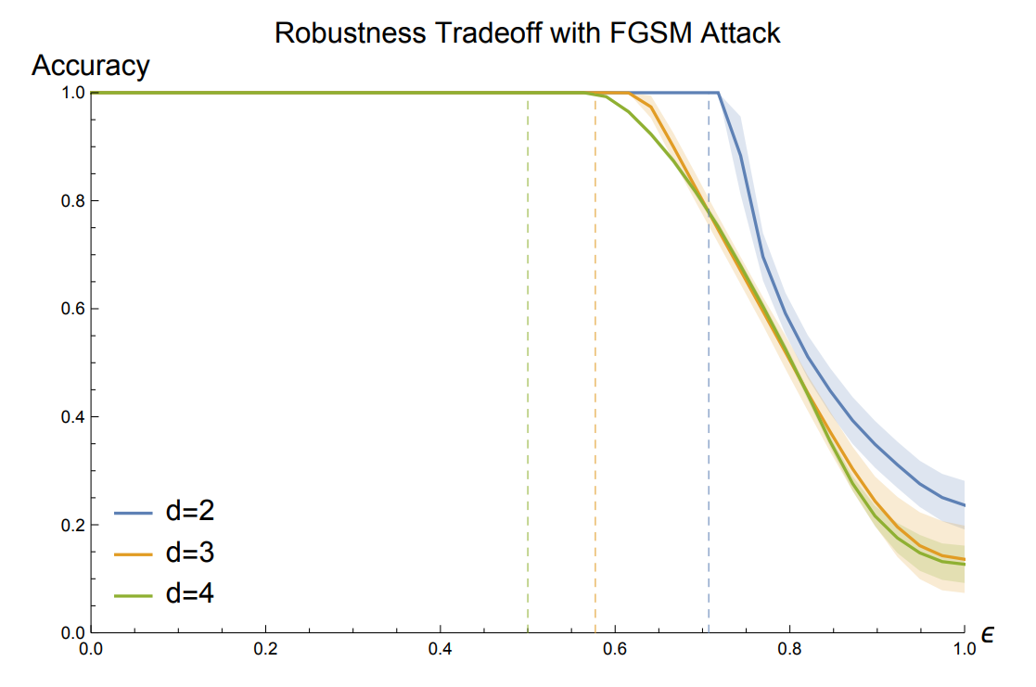
3. Theorem

Slide 9
3. Theorem
NN has sample efficiency at adversarial training
High Codimension reduces robustness
Adversarial perturbations are in the directions Normal to the Data Manifold

Slide 10
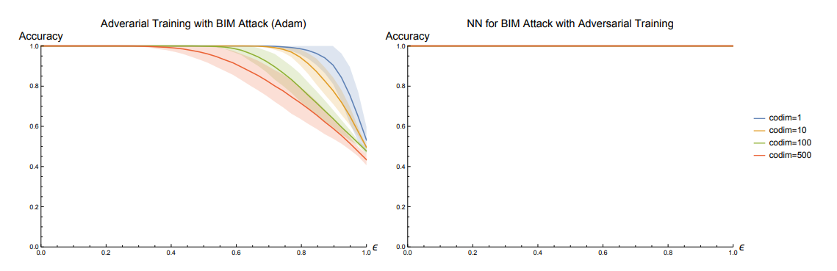
4. Experiments

Slide 11
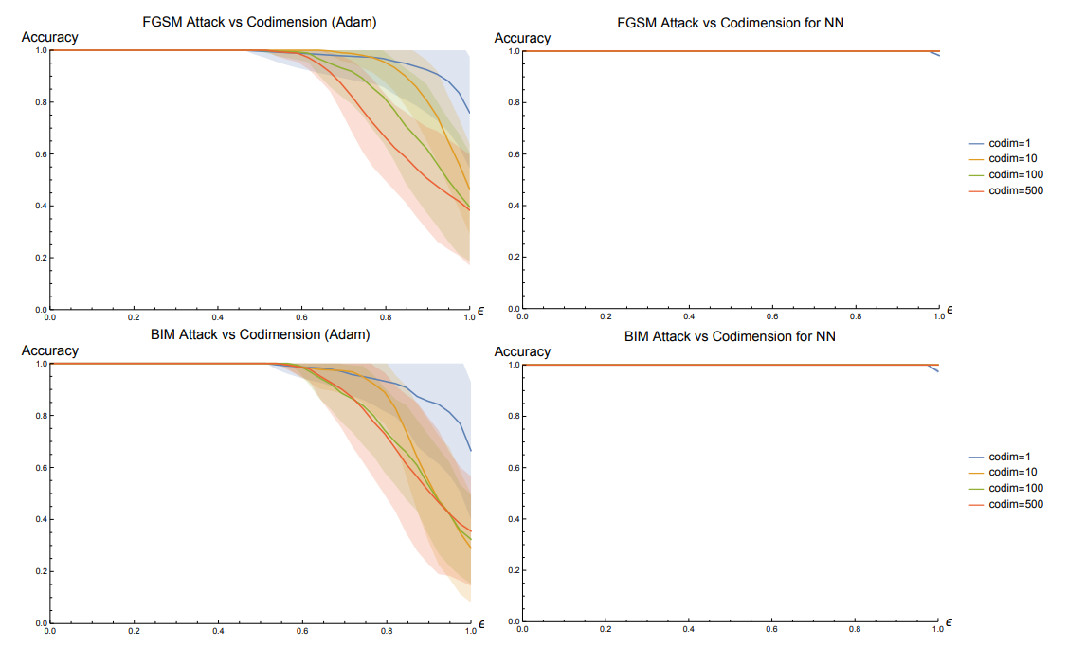
4. Experiments

Slide 12
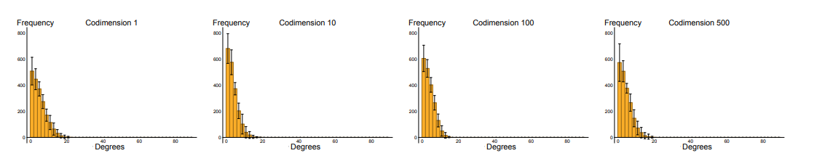
4. Experiments

Slide 13
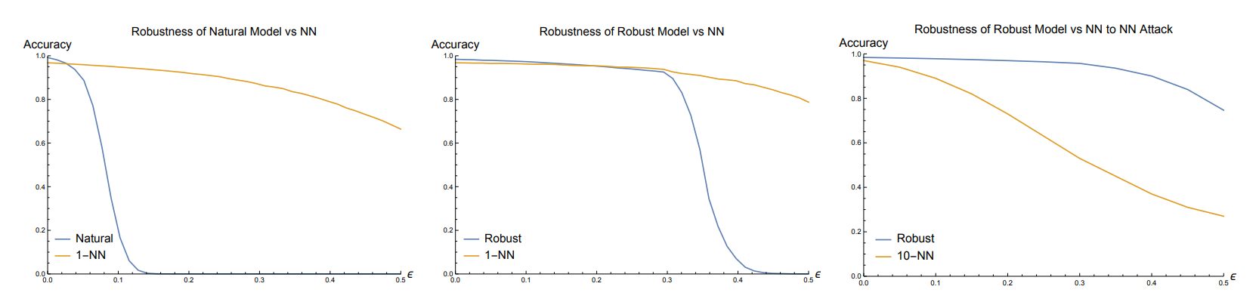
4. Experiments
MNIST

Slide 14
5. Conclusion
Idea
1. Codimension을 줄이는 방향으로 학습 (projectio을 잘하기)
2. Manifold의 normal 방향의 gradien의 값 혹은 expectation 을 0으로 학습
3. Mean-Variance optimization (원래는 robust optimization을 사용했는데, 요즘은 Adam variation들을 많이 사용하는 듯)

